Slide 2

Ypp 4
bbv Software Services AG | Date: 21/07/2025

Slide 3




Presentation on MS Lists Functionalities
bbv Software Services AG | Date: 21/07/2025

Slide 4
Agenda
Introduction
Key Functionalities
Q&A

Slide 5

Introduction
What is MS Lists?

Slide 6
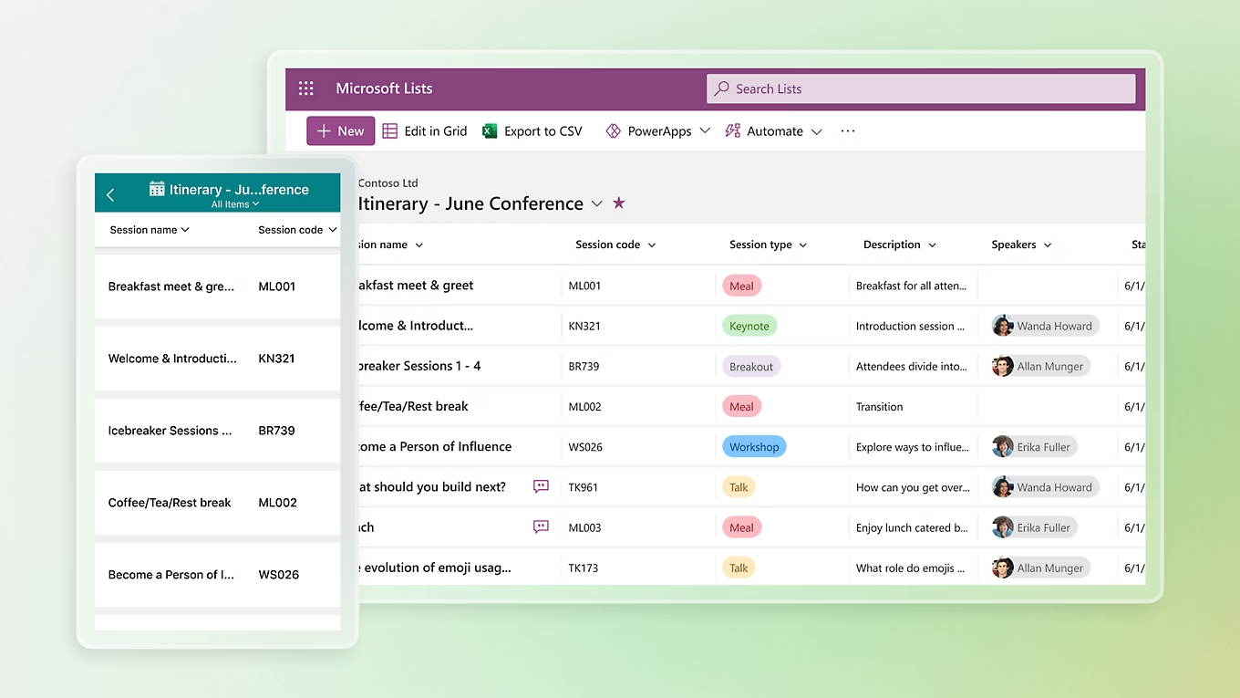
Introduction
What is Microsoft Lists
MS List is a tool for managing structured lists of data
Works like a simple table or database
Let’s users:
Create lists
View data
Manage info clearly and easily

Slide 7

Key Functionalitie

Slide 8

Key Functionalities of MS Lists
Create and Manage Lists
Custom Columns
Manage List Items
Custom Views
Conditional Formatting
Permissions and Sharing
Built-in Templates

Slide 9
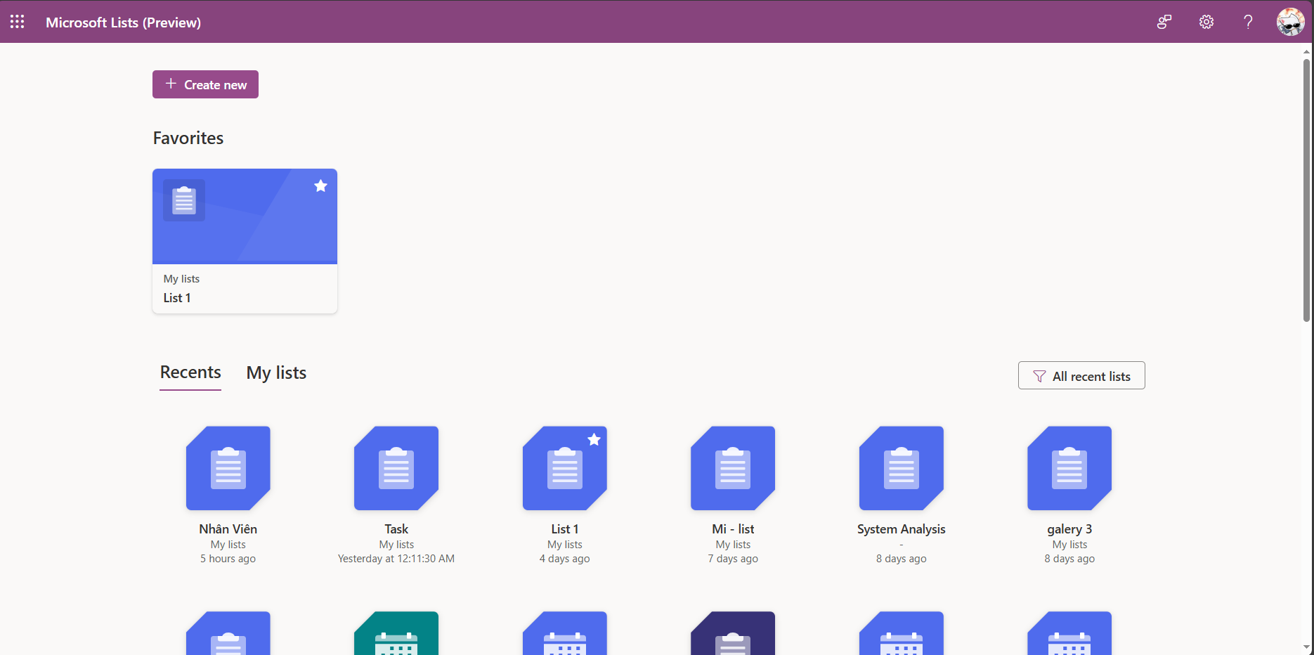
Dashboard Screen
FavoriteList
RecentList
List
ListName
WorkspaceId
Icon
Color
LastAccessedAt
Notes:
-- 1. Display all lists that the logged-in user created or were shared with them
DECLARE @UserId INT = 2; -- Replace with the ID of the logged-in user
SELECT DISTINCT
l.Id,
l.ListName,
l.Icon,
l.Color,
lmp.HighestPermissionCode, -- Extra
lmp.GrantedByAccountId -- Extra
FROM List l
JOIN ListMemberPermission lmp ON l.Id = lmp.ListId AND lmp.AccountId = @UserId -- JOIN is still used because the creator will be added to ListMemberPermission
WHERE l.CreatedBy = @UserId
OR lmp.Id IS NOT NULL
AND l.ListStatus = 'Active';
GO
-- 2. Display all lists that the logged-in user created
DECLARE @UserId INT = 2;
SELECT
l.ListName,
l.Icon,
l.Color
FROM List l
WHERE l.CreatedBy = @UserId
AND l.ListStatus = 'Active';
GO
-- 4. Display favorite lists of the logged-in user
DECLARE @UserId INT = 2; -- Replace with the ID of the logged-in user
SELECT
l.Id,
l.ListName,
l.Icon,
l.Color
FROM FavoriteList fl
INNER JOIN List l ON fl.ListId = l.Id
WHERE fl.FavoriteListOfUser = @UserId
AND l.ListStatus = 'Active'
ORDER BY fl.CreatedAt DESC;
GO

Slide 10
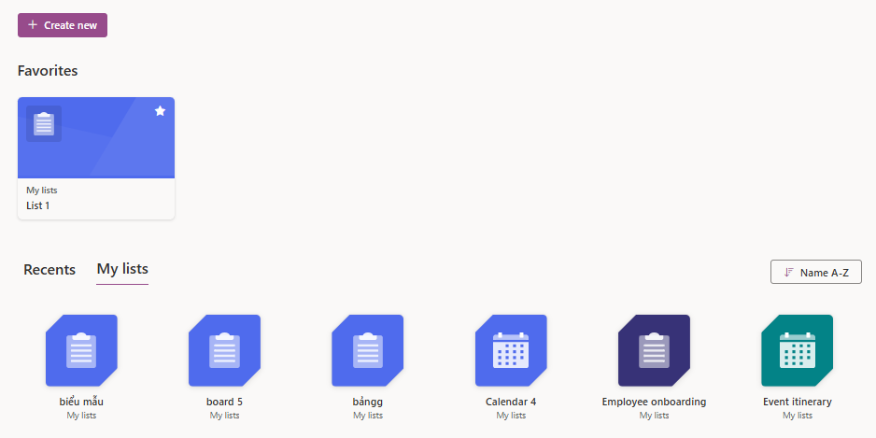
Dashboard Screen
Workspace
Workspace. WorkspaceName
Workspace. IsPersonal = true

Slide 11
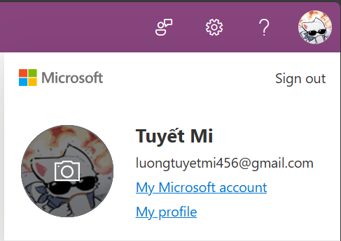
Dashboard Screen
Account
Account.FirstName
Account.LastName
Account.Avatar
Account.Email
Notes:
-- 3. Display information of the logged-in user
DECLARE @UserId INT = 2;
SELECT
a.Id,
a.FirstName,
a.LastName,
a.Avatar,
a.Email,
a.Company,
a.AccountStatus
FROM Account a
WHERE a.Id = @UserId;
GO

Slide 12
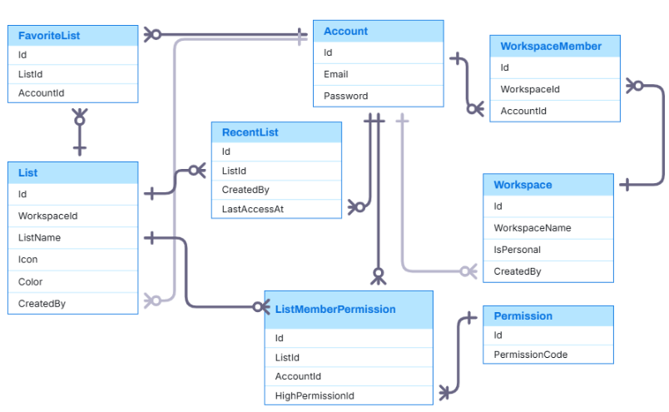
Entity Relationship

Slide 13
Dashboard Sample Data

Slide 14
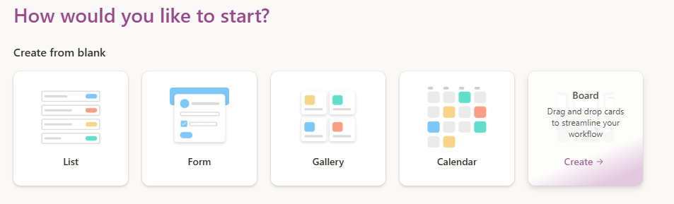
Create List Screen
ListType
ListType.Title
ListType. ListTypeDescription
ListType.HeaderImage
Notes:
-- 1. Display all list types for selection
SELECT
Title,
ListTypeDescription,
HeaderImage
FROM ListType
ORDER BY Title;

Slide 15
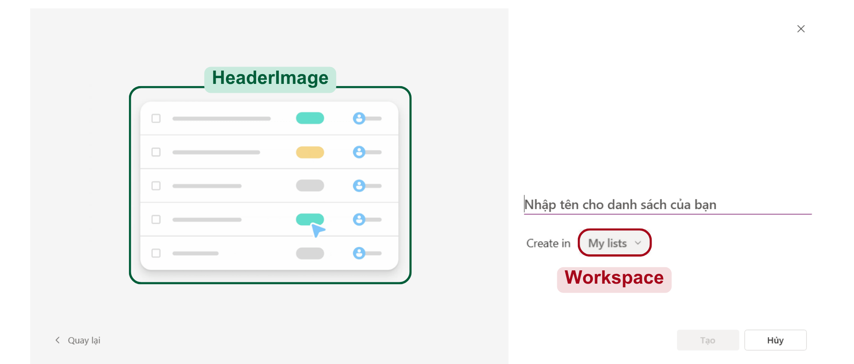
Create List From List Type
List
ListType
List.ListName

Slide 16
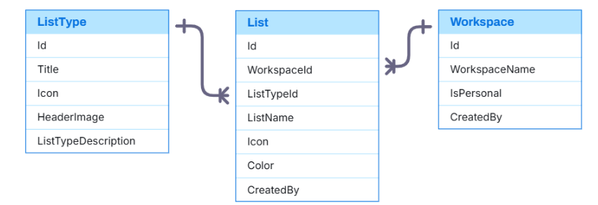
Entity Relationship

Slide 17
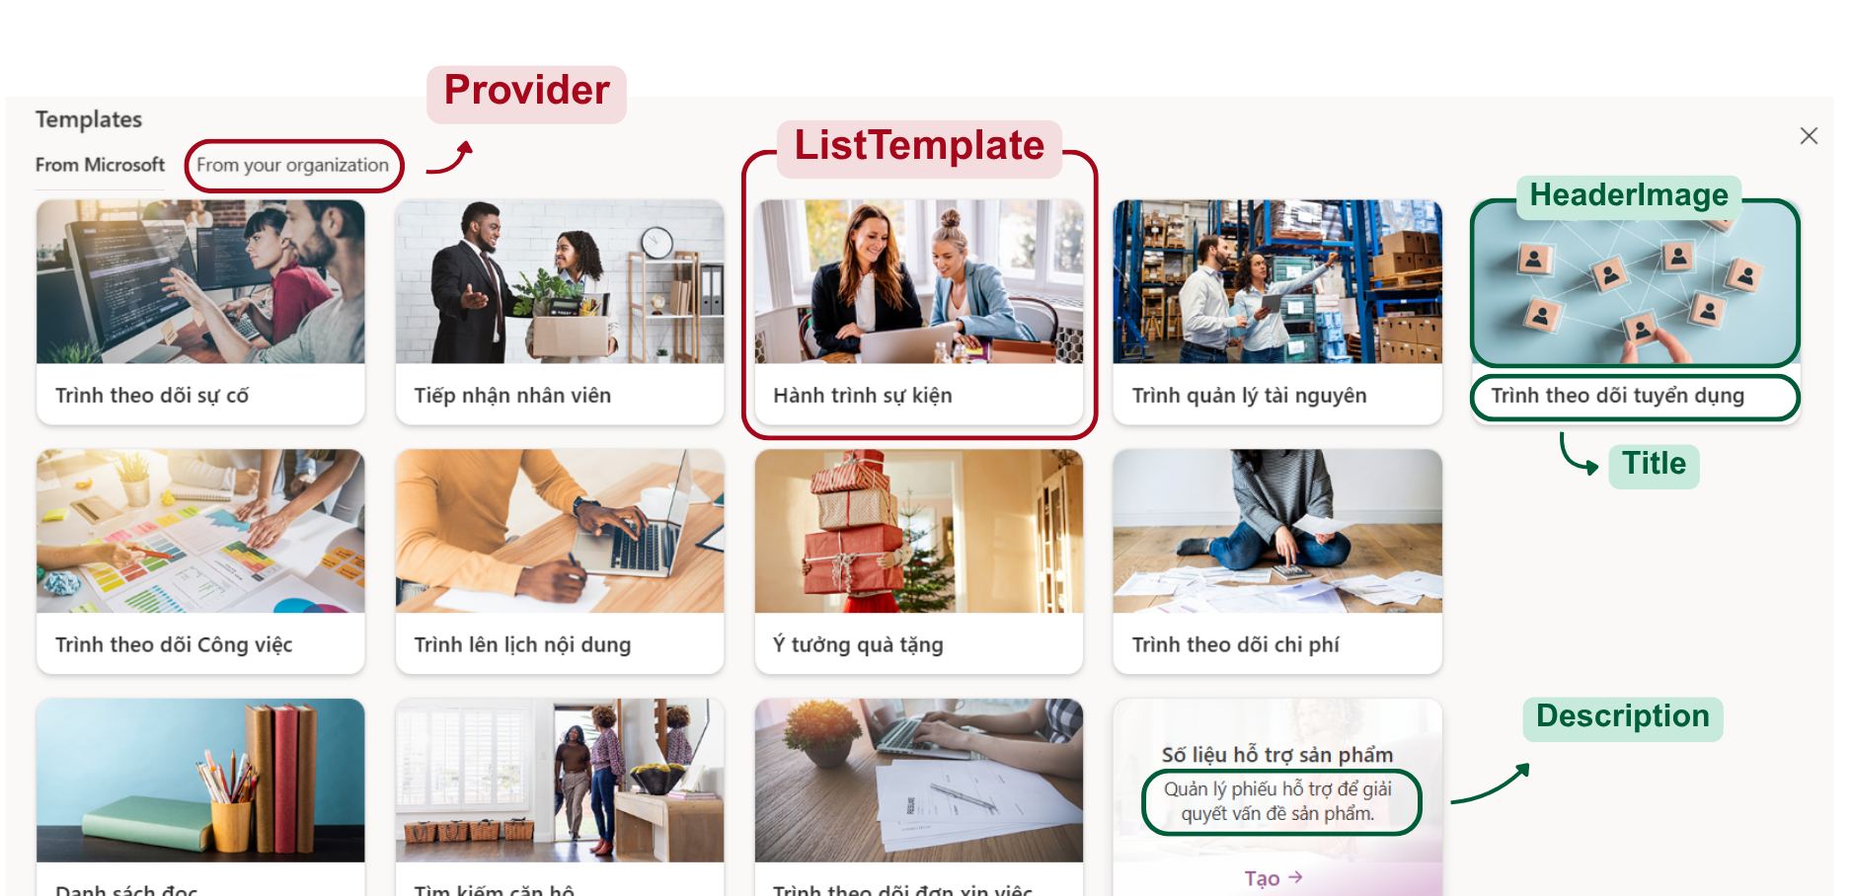
Create List Screen
Notes:
-- 2. Display all templates
SELECT
lt.Title,
lt.HeaderImage,
lt.Sumary,
pr. ProviderName
FROM ListTemplate lt
JOIN Provider pr ON lt.ProviderId = pr.Id
ORDER BY lt.Title;

Slide 18
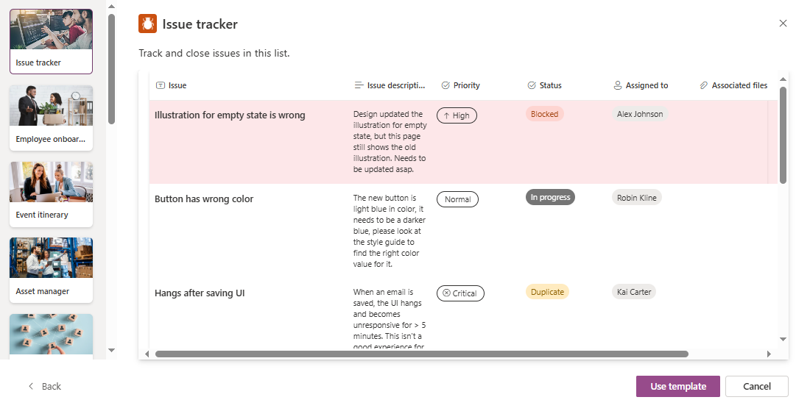
List Template
ListTemplate
ListTemplate.Icon / Color / Title
TemplateView
ListTemplate.TemplateDescription

Slide 19
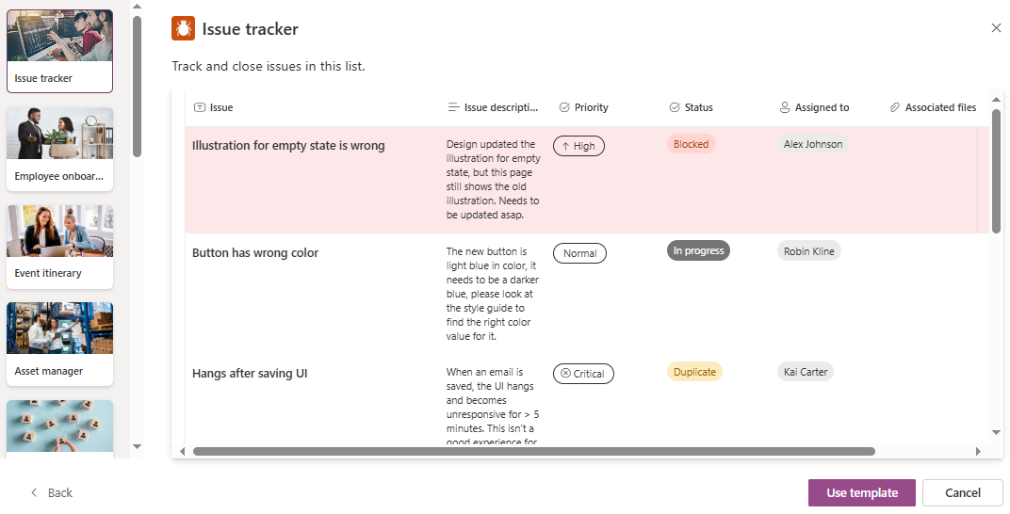
List Template
TemplateColumn
TemplateColumn. Icon / ColumnName
TemplateCellValue
TemplateRow

Slide 20
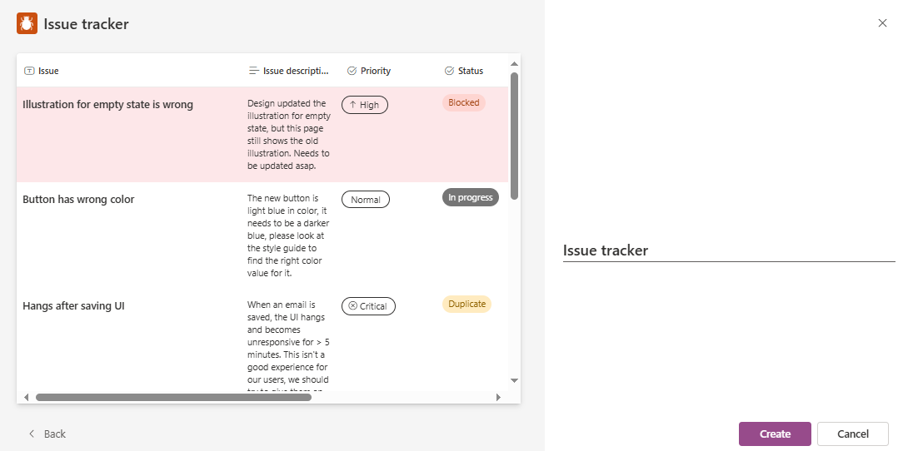
Create List from Template
List
ListTemplate
List.ListName

Slide 21
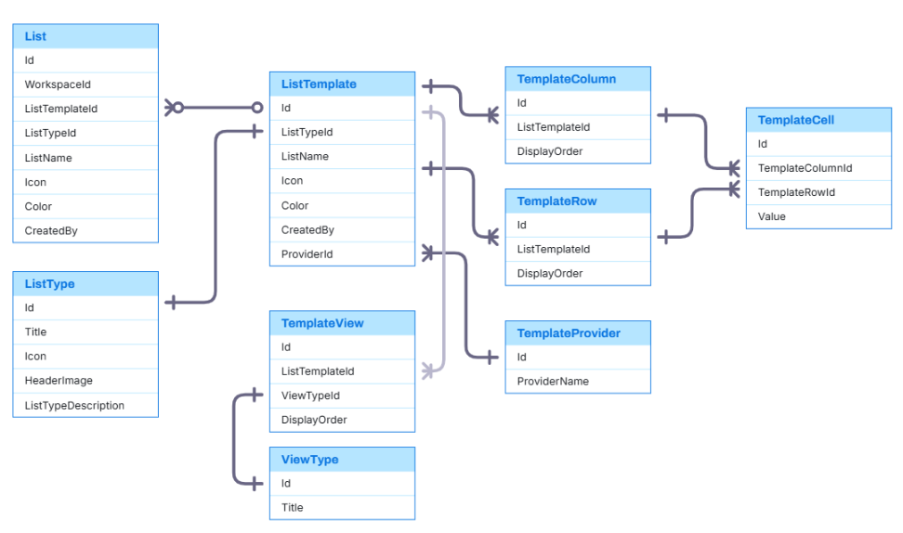
Entity Relationship

Slide 22
Create List Sample Data

Slide 23
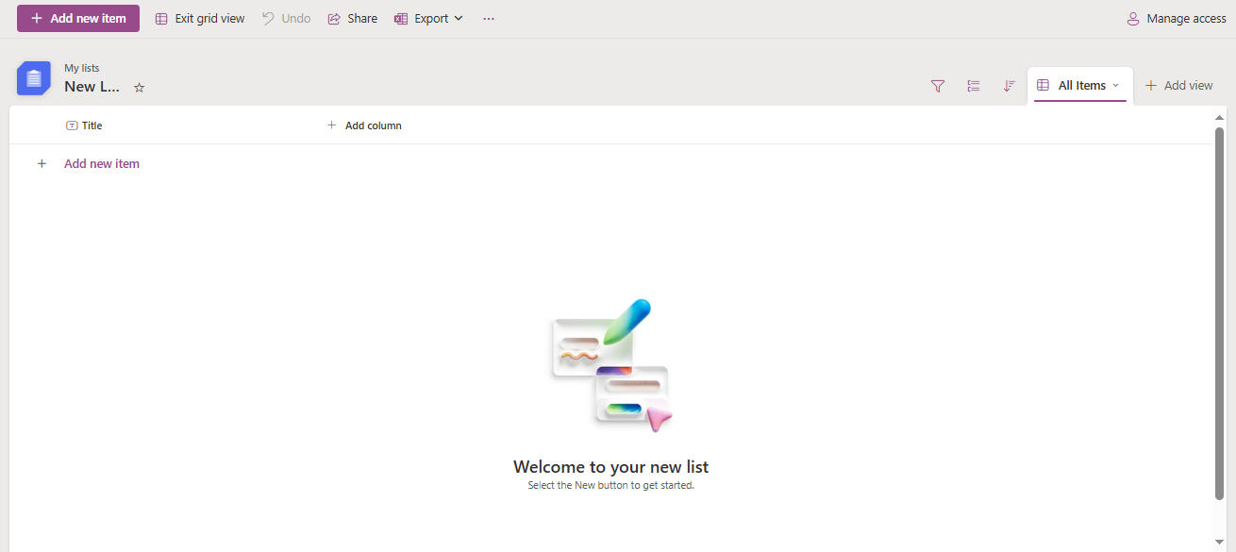
List

Slide 24
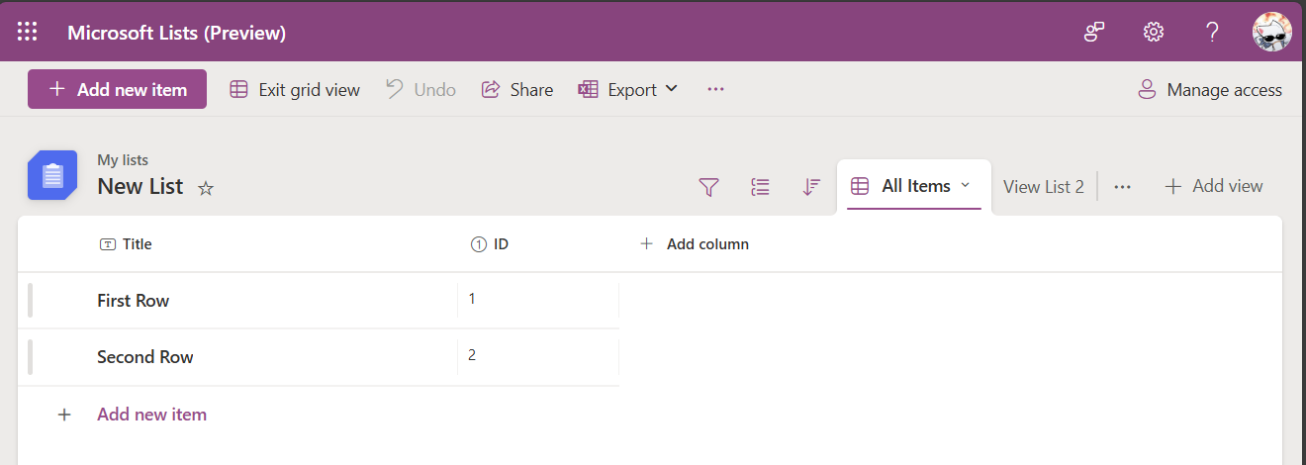
List
ListTemplate
List
List.ListName
List.WorkspaceId
List.Color
List.Icon
FavoriteList.Listid
ListDynamicColumn
ListView
ListRow
CellValue

Slide 25
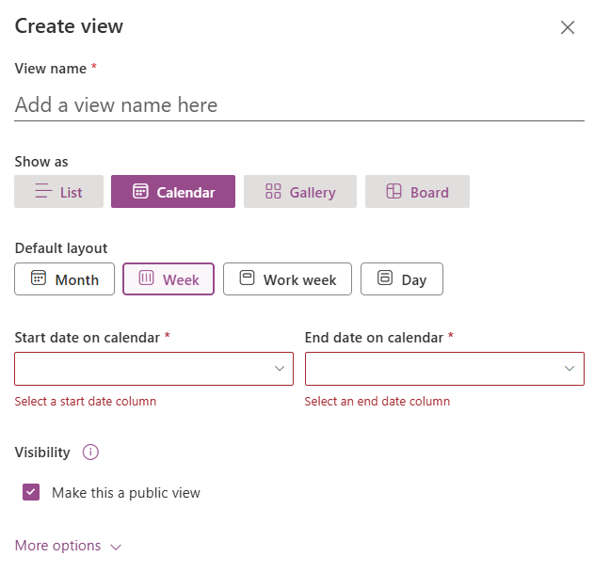
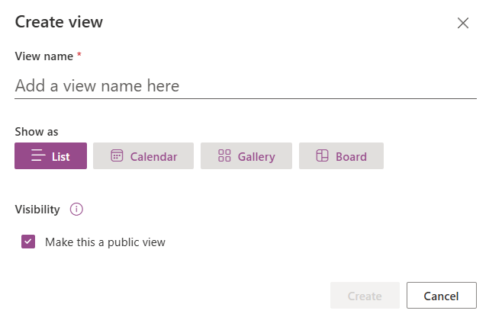
Create View
ListView
ViewType
KeySetting
KeySetting.KeyName
KeySetting.ValueType
(e.x: Text. Number, Boolean,…)

Slide 26
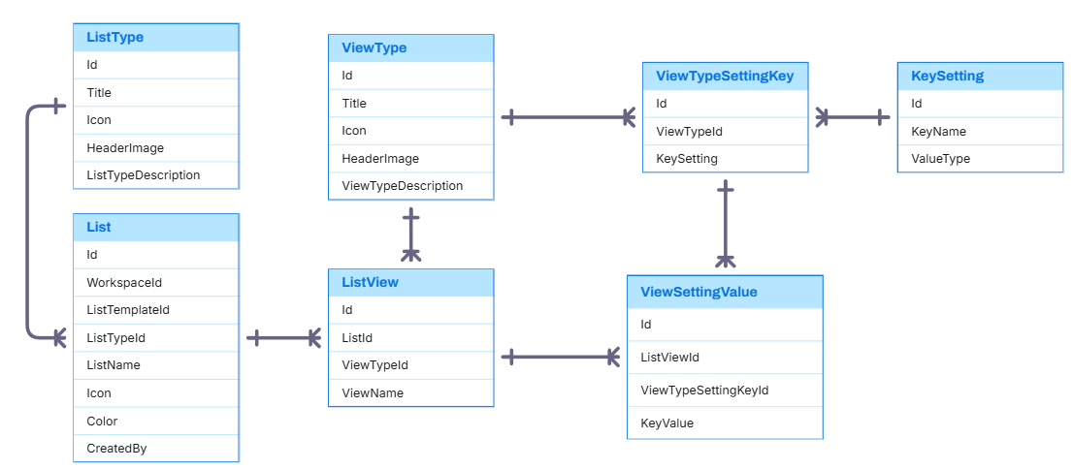
Entity Relationship

Slide 27
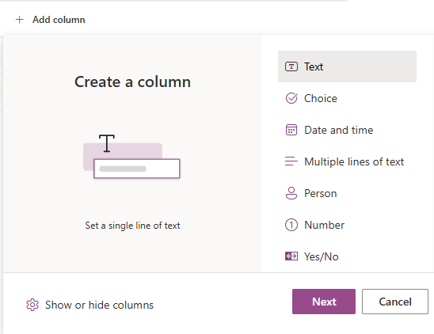
Dynamic Column
SystemDataType
SystemDataType.Icon
SystemDataType. DisplayName
SystemDataType.CoverImg
SystemDataType.DataDiscription
ListDynamicColumn

Slide 28
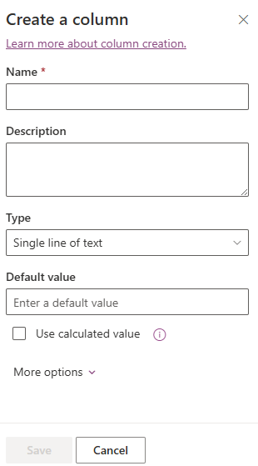
Create Dynamic Column
ListDynamicColumn
n
ListDynamicColumn.ColumnName
ListDynamicColumn.ColumnDescription
1
SystemDataType

Slide 29
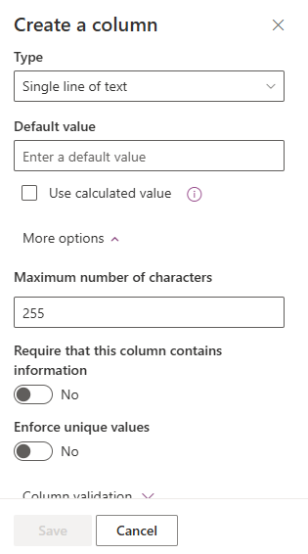
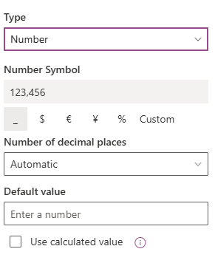
Create Dynamic Column
ListDynamicColumn
SystemDataType
1
n
DataSettingKey
n
1
KeySetting
KeySetting.KeyName
KeySetting.ValueType (e.x: Text. Number, Boolean,…)

Slide 30
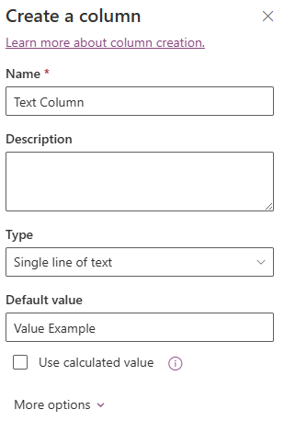
DataTypeSettingKey
ListDynamicColumn
DataSettingKey.SystemDataType
DataSettingKey.KeySetting
DataSettingKey
DynamicColumnSettingValue. KeyValue

Slide 31
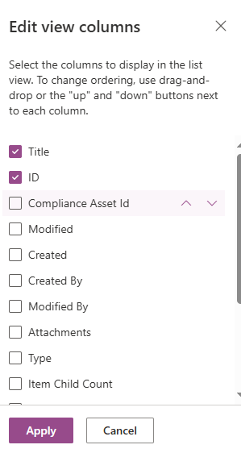
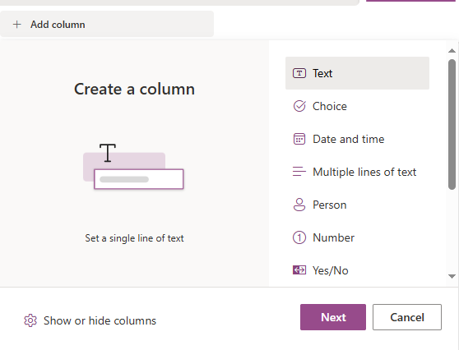
SystemColumn
Each list will have default columns based on system columns, and these columns can be hidden depending on the view.
ListViewColumn
ListDynamicColumn.Name
ListViewColumn.IsVisible
ListViewColumn. DisplayOrder

Slide 32
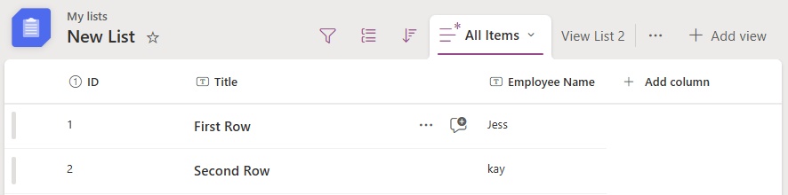
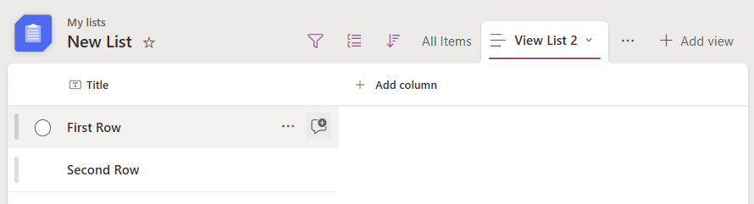
Flexible Column Display
View “All Items”
Each view can customize which columns are visible and their order.
1
2
3
View “View List 2”
1

Slide 33
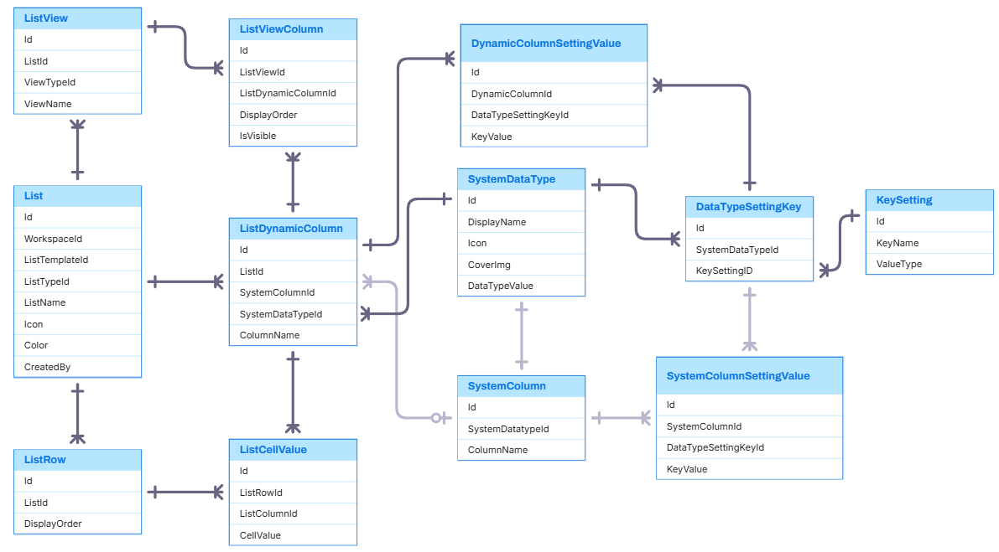
Entity Relationship

Slide 34
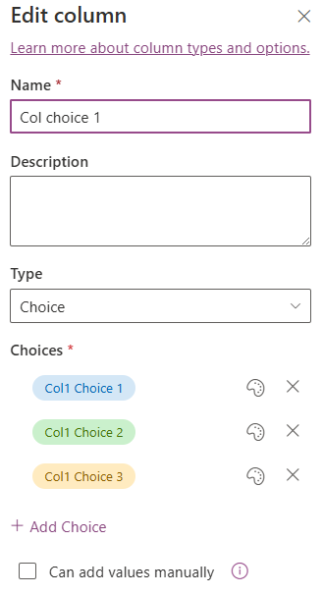
SystemDataType
SystemDataType
ListColumnChoice
ListColumnChoice.ChoiceValue
ListColumnChoice.Color
ListColumnChoice.DisplayOrder

Slide 35
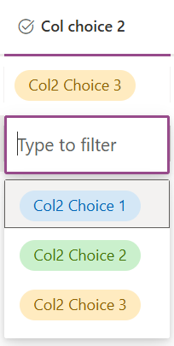
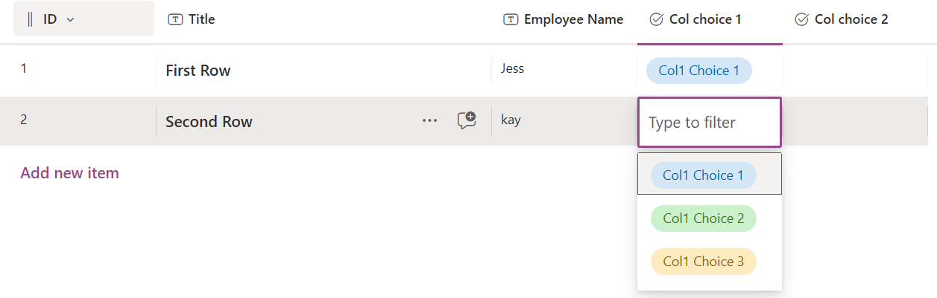
SystemDataType
ListDynamicColumn.Id = 2
ListDynamicColumn.Id = 1
ListColumnChoice
=> Each choice belongs to exactly one ListDynamicColumn (Id).

Slide 36
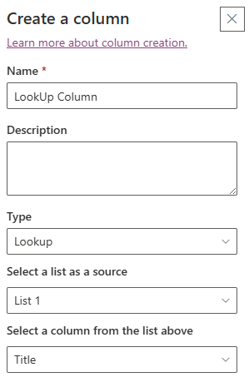
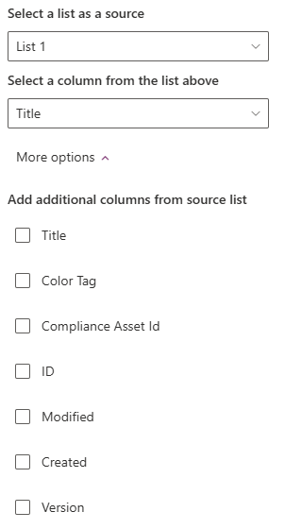
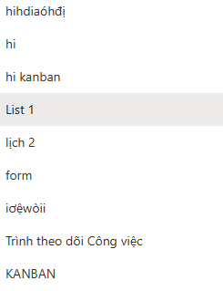
SystemDataType
ListDynamicColumn
List
ListDynamicColumn.ListId
ListId
ListDynamicColumn.ListId

Slide 37
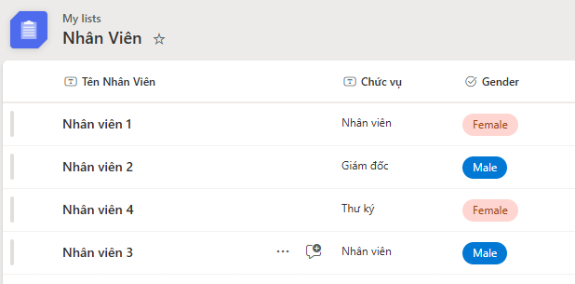

Slide 38
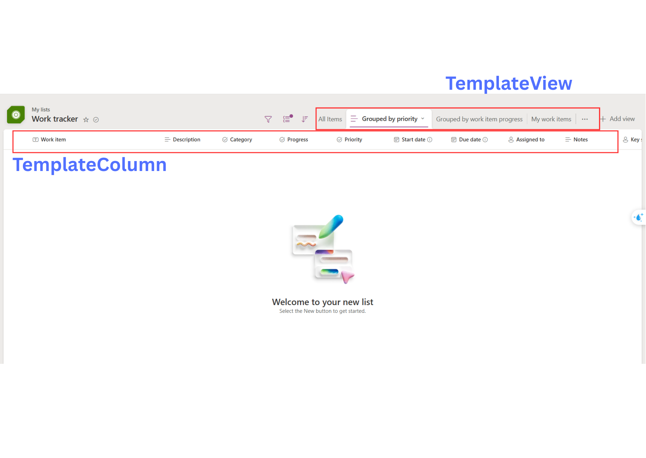
Template View & Template Column

Slide 39
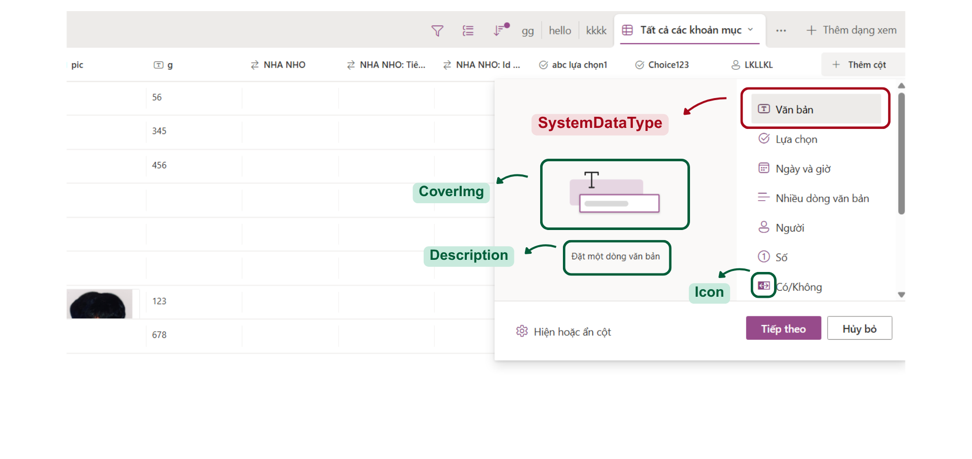
List Column
Notes:
-- 1. Display all Data Types of the Column.
SELECT
sd.CoverImg,
sd.DataTypeDescription,
sd.Icon,
sd.DisplayName
FROM SystemDataType sd
GO

Slide 40
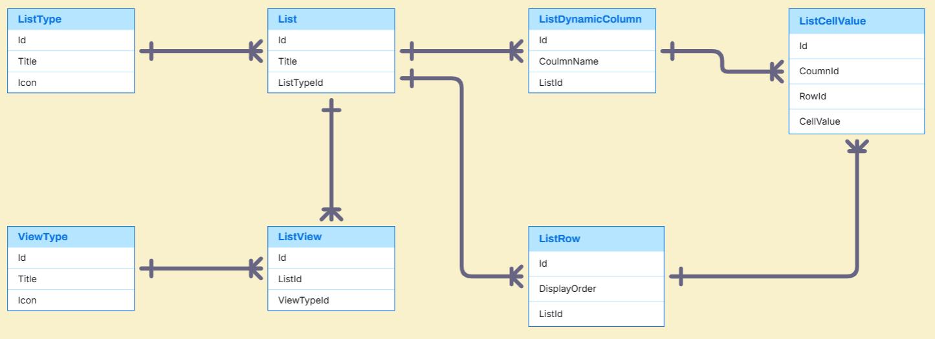
List Entities

Slide 41
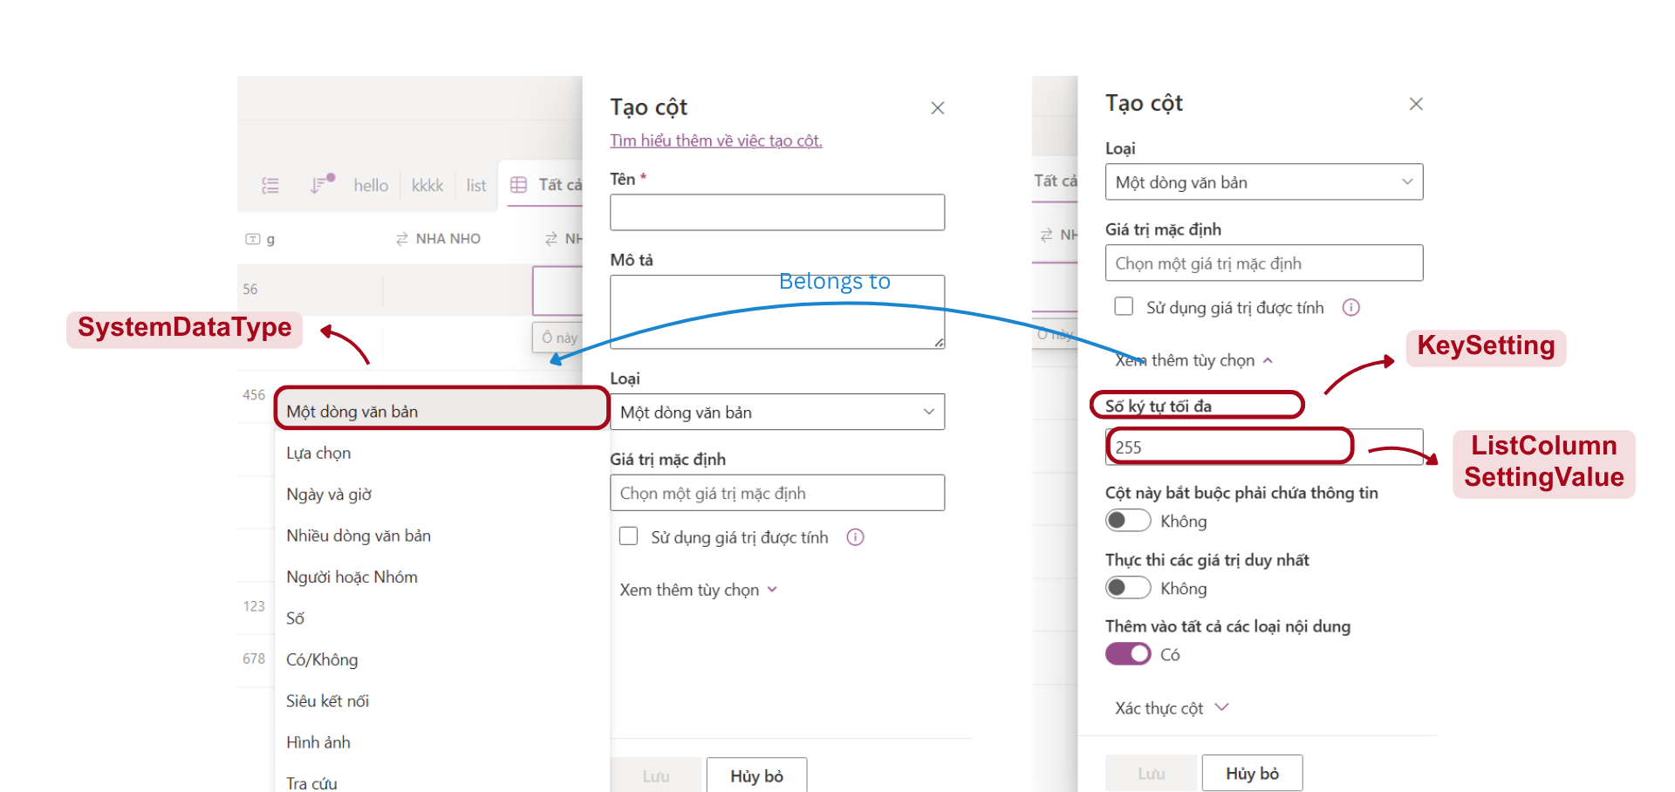
List Column Setting
Notes:
-- 2. Display Key Settings corresponding to that Data Type.
DECLARE @SystemDataTypeId INT = 1;
SELECT
sd.DisplayName,
ks.KeyName,
ks.ValueType
FROM KeySetting ks
JOIN DataTypeSettingKey dsk ON ks.Id = dsk.KeySettingId
JOIN SystemDataType sd ON dsk.SystemDataTypeId = sd.Id
WHERE dsk.SystemDataTypeId = @SystemDataTypeId
GO

Slide 42
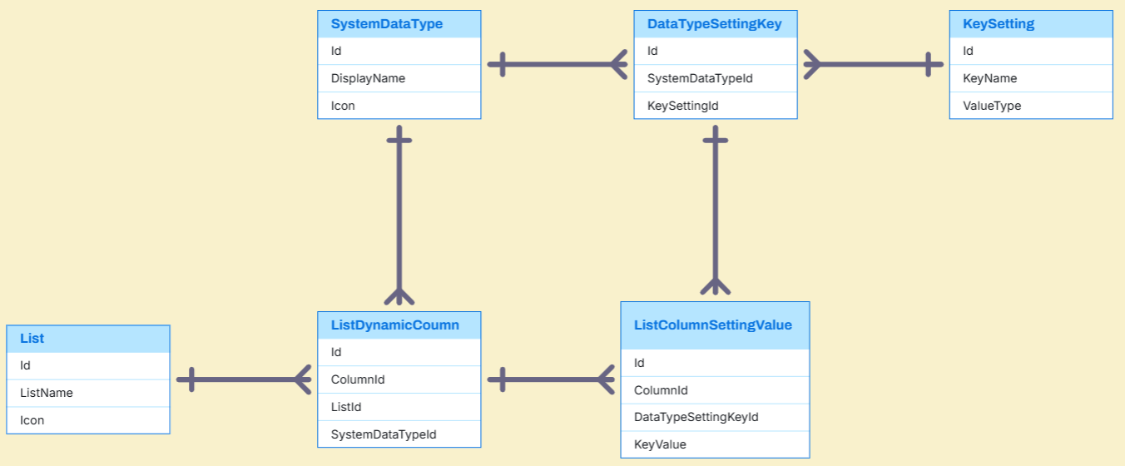
List Column Setting Entities

Slide 43
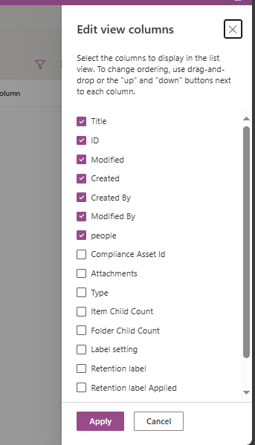
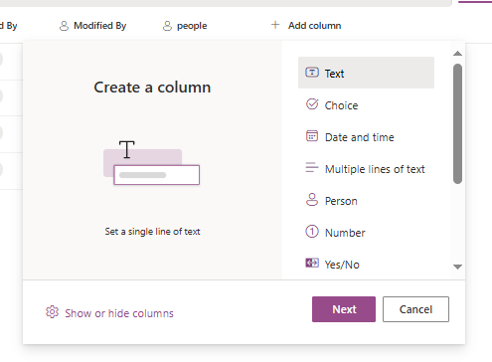
System column
System columns
Notes:
-- 4. Display all Dynamic Columns
DECLARE @ListId INT = 2;
SELECT
dc.ColumnName,
dc.IsVisible,
dc.DisplayOrder
FROM ListDynamicColumn dc
WHERE dc.ListId = @ListId
ORDER BY dc.DisplayOrder;
GO

Slide 44
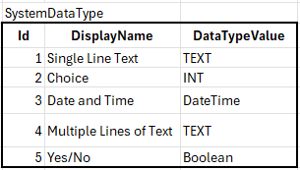
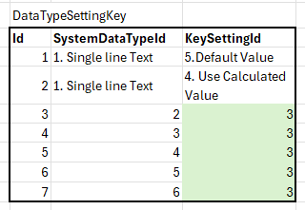
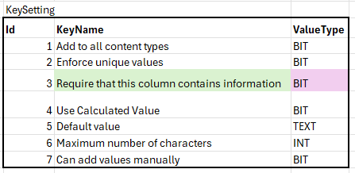
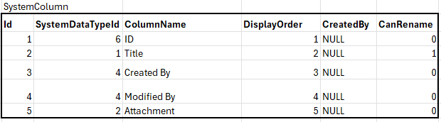
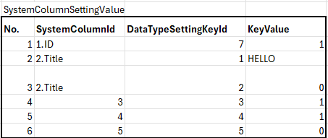
System Column example data

Slide 45
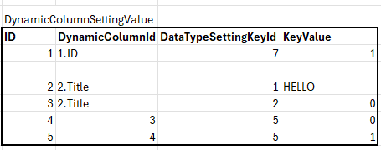
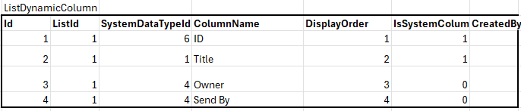
Dynamic Column example data

Slide 46
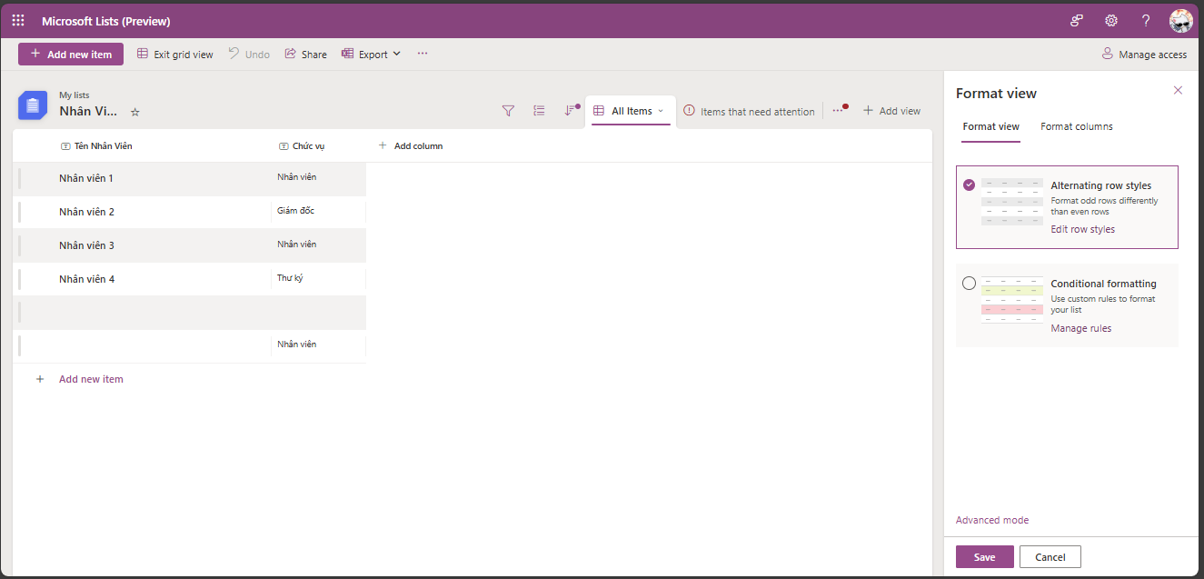
Format View

Slide 47


Format View

Slide 48


Format Column

Slide 49

List View

Slide 50

List View Entities

Slide 51

List View Sample Data

Slide 52

Manage Access

Slide 53

Manage Access

Slide 54

Manage Access Entities

Slide 55

Manage Access Sample Data

Slide 56

Trash

Slide 57
Q&A

